Slide 1
Software Testing

Slide 2
Software Testing is also called V&V
Verification: The software correctly implements a specific function.
It responds to “Are we building the product right?”
Validation: The software is traceable to the customer requirements.
It responds to: “Are we building the right product?”

Slide 3
Chapter 13
Software Testing Strategies
Strategy: Art of devising or employing plans towards a goal.
Tactic: Small-scale actions serving a larger purpose or goal.

Slide 4
Software Testing
Testing is the PROCESS of exercising a
program with the specific intent of finding
errors prior to delivery to the end user.
Testing provides the last line of defense from which quality may be assessed and errors can be uncovered.
Testing is not a safety net: if quality was not there in the first place it will not be there after testing is finished.

Slide 5
Generic Characteristics of Software Testing Strategies => TP
A S/W team should conduct effective formal technical
reviews to eliminate as many errors as possible before the testing begins.
Testing begins at the component level and works
“outwards” towards the integration of the entire S/W.
Different testing techniques are appropriate at different
testing points.
Testing is conducted by the developer of the S/W and
(for large projects) and independent test group.
Testing and debugging are different activities, the latter
must accommodate to any testing strategy.
Testing must accommodate low-level tests (small source code) and high-level tests (major system functions validation).
Testing strategies provide guidance for the practitioner and milestones for the manager.

Slide 6

What Testing Shows
errors
requirements conformance
performance
an indication
of quality

Slide 7


Who Tests the Software?
< S.R.D. >
< T.P. >
< U.G. >
developer
independent tester
Understands the system
Must learn about the system,
but, will test "gently"
but, will attempt to break it
and, is driven by "delivery"
and, is driven by quality

Slide 8

Testing Strategy
unit test
(code)
integration
test
(design)
system
test
(system engineering)
validation
test
(requirements)

Slide 9
Testing Strategy
We begin by ‘testing-in-the-small’ and move toward ‘testing-in-the-large’
For conventional software
  The module (component) is our initial focus
  Integration of modules follows
For OO software
  our focus when “testing in the small” changes from an individual module (the conventional view) to an OO class that encompasses attributes and operations and implies communication and collaboration

Slide 10
Strategic Issues
State testing objectives explicitly (these should be detailed in the test plan).
Specify product requirements in a quantifiable manner long before testing commences. (Include Portability, Maintainability & Usability).
Understand the users of the software and develop a profile for each user category.
Develop a testing plan that emphasizes “rapid cycle testing.”
Build “robust” software that is designed to test itself
Use effective formal technical reviews as a filter prior to testing
Conduct formal technical reviews to assess the test strategy and test cases themselves.
Develop a continuous improvement approach for the testing process.

Slide 11

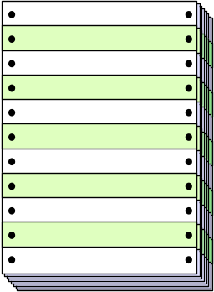
Unit Testing
module
to be
tested
results
software
engineer
test cases

Slide 12
Unit Test Environment
driver
interface
local data structures
Module
boundary conditions
independent paths
error handling paths
stub
stub
test cases
RESULTS

Slide 13

Integration Testing Strategies
Options:
  • the “big bang” approach
  • an incremental construction strategy

Slide 14
Top Down Integration
A
top module is tested with
stubs
B
F
G
stubs are replaced one at
a time, "depth first"
C
as new modules are integrated,
some subset of tests is re-run
D
E

Slide 15
Bottom-Up Integration
A
B
F
G
drivers are replaced one at a
time, "depth first"
C
worker modules are grouped into
builds and integrated
D
E
cluster

Slide 16
Sandwich Testing
A
Top modules are
tested with stubs
B
F
G
C
Worker modules are grouped into
builds and integrated
D
E
cluster

Slide 17
Object-Oriented Testing
begins by evaluating the correctness and consistency of the OOA and OOD models
testing strategy changes
  the concept of the ‘unit’ broadens due to encapsulation
  integration focuses on classes and their execution across a ‘thread’ or in the context of a usage scenario
  validation uses conventional black box methods
test case design draws on conventional methods, but also encompasses special features

Slide 18
Broadening the View of “Testing”
It can be argued that the review of OO analysis and design models is especially useful because the same semantic constructs (e.g., classes, attributes, operations, messages) appear at the analysis, design, and code level. Therefore, a problem in the definition of class attributes that is uncovered during analysis will circumvent side effects that might occur if the problem were not discovered until design or code (or even the next iteration of analysis).

Slide 19
Testing the CRC Model
1. Revisit the CRC model and the object-relationship model.
2. Inspect the description of each CRC index card to determine if a delegated responsibility is part of the collaborator’s definition.
3. Invert the connection to ensure that each collaborator that is asked for service is receiving requests from a reasonable source.
4. Using the inverted connections examined in step 3, determine whether other classes might be required or whether responsibilities are properly grouped among the classes.
5. Determine whether widely requested responsibilities might be combined into a single responsibility.
6. Steps 1 to 5 are applied iteratively to each class and through each evolution of the OOA model.

Slide 20
OOT Strategy
class testing is the equivalent of unit testing
  operations within the class are tested
  the state behavior of the class is examined
integration applied three different strategies
  thread-based testing—integrates the set of classes required to respond to one input or event
  use-based testing—integrates the set of classes required to respond to one use case
  cluster testing—integrates the set of classes required to demonstrate one collaboration

Slide 21
Smoke Testing
A common approach for creating “daily builds” for product software
Smoke testing steps:
  Software components that have been translated into code are integrated into a “build.”
    A build includes all data files, libraries, reusable modules, and engineered components that are required to implement one or more product functions.
  A series of tests is designed to expose errors that will keep the build from properly performing its function.
    The intent should be to uncover “show stopper” errors that have the highest likelihood of throwing the software project behind schedule.
  The build is integrated with other builds and the entire product (in its current form) is smoke tested daily.
    The integration approach may be top down or bottom up.

Slide 22
High Order Testing
Validation testing
  Focus is on software requirements. Use S/W Requirements Specification
System testing
  Focus is on system integration
Alpha/Beta testing
  Focus is on customer usage. Alpha is conducted by end-users at developer site. Beta is conducted at end-user sites with no developer supervision.
Recovery testing
  forces the software to fail in a variety of ways and verifies that recovery is properly performed (MTTR = mean time to repair)
Security testing
  verifies that protection mechanisms built into a system will, in fact, protect it from improper penetration
Stress testing
  executes a system in a manner that demands resources in abnormal quantity, frequency, or volume
Performance Testing
  test the run-time performance of software within the context of an integrated system

Slide 23

Debugging:
A Diagnostic Process

Slide 24
The Debugging Process
test cases
new test
cases
results
regression
tests
suspected
causes
corrections
Debugging
identified
causes

Slide 25
Debugging Effort
time required
to diagnose the
symptom and
determine the
cause
time required
to correct the error
and conduct
regression tests

Slide 26
Symptoms & Causes
symptom and cause may be
geographically separated
symptom may disappear when
another problem is fixed
cause may be due to a
combination of non-errors
cause may be due to a system
or compiler error
symptom
cause may be due to
assumptions that everyone
cause
believes
symptom may be intermittent

Slide 27
Consequences of Bugs
infectious
damage
catastrophic
extreme
serious
disturbing
annoying
mild
Bug Type
Bug Categories:
function-related bugs,
system-related bugs, data bugs, coding bugs,
design bugs, documentation bugs, standards
violations, etc.

Slide 28
Debugging Techniques
Brute force / testing – most common & least effective
Backtracking – successful in small programs
Cause elimination – Two types:
  Induction
  Deduction
Automatic debugging tools – semi automated support
People factor – to help and to better debug…

Slide 29
Debugging: Final Thoughts
1.
Don't run off half-cocked,
think
about the
symptom you're seeing.
2.
Use tools
(e.g., dynamic debugger) to gain
more insight.
3.
If at an impasse,
get help
from someone else.
4.
Be absolutely sure to
conduct regression tests
when you do "fix" the bug.

Slide 30
Chapter 14
Software Testing Techniques

Slide 31
Testability
S/W testability is how easily a computer S/W system can be tested.
The following leads to easily testable computer S/W:
Operability—it operates cleanly
Observability—the results of each test case are readily observed
Controllability—the degree to which testing can be automated and optimized
Decomposability—testing can be targeted by the presence of independent modules
Simplicity—reduce complex architecture and logic to simplify tests
Stability—few changes are requested during testing
Understandability—of the design, the more we know/understand about the system the better we will test (documentation is a plus)

Slide 32
What is a “Good” Test?
A good test has a high probability of finding an error
A good test is not redundant.
A good test should be “best of breed”
A good test should be neither too simple nor too complex

Slide 33
Test Case Design
"Bugs lurk in corners
and congregate at
boundaries ..."
Boris Beizer
OBJECTIVE
to uncover errors
CRITERIA
in a complete manner
CONSTRAINT
with a minimum of effort and time

Slide 34
Exhaustive Testing
loop < 20 X
In this small program there are 10¹⁴ possible paths! If we execute one test per millisecond, it would take 3,170 years to test this program!!

Slide 35
Selective Testing
Selected path
loop < 20 X

Slide 36
Software Testing
white-box
methods
black-box
methods
Methods
Strategies

Slide 37
Black-Box Testing
... allures to tests conducted at the software interface to examine some fundamental aspect of the S/W system with little regard for the internal logical structure of the S/W more later (p. 54 on).

Slide 38

White-Box or “Glass Box” Testing
... our goal is to ensure that all
statements and conditions have
been executed at least once ...

Slide 39
White-Box or “Glass Box” Testing
There is only one rule while designing test cases:
* cover all the features
* do not make too many test cases
… and remember:
“bugs lurk in corners and congregate at boundaries!”

Slide 40
Why Cover all Features?
logic errors and incorrect assumptions
are inversely proportional to a path's
execution probability
we often
believe
that a path is not
likely to be executed; in fact, reality is
often counter intuitive
typographical errors are random; it's
likely that untested paths will contain
some

Slide 41
Basis Path Testing: a white-box technique
Steps:
* Represent control flow using a flow graph
* Evaluate the cyclomatic complexity V(G) of the program
* Consider the value of V(G) as an upper bound for the number
of independent testing paths that form the basis testing set.

Slide 42
Basis Path Testing: a white-box technique
Definitions:
* The basis testing set is the number of tests that must be
designed and executed to “guarantee” coverage of all
program statements.
* Predicate node is a node that contains a condition and it is
characterized by two or more edges emanating from it.
* Cyclomatic complexity is a software metric that provides
a quantitative measure of the of the logical complexity of a
program.
* Independent path is a path in the flow graph that introduces
at least one new set of of processing statements or a new
condition.

Slide 43
Basis Path Testing: a white-box technique
Three ways of computing V(G):
1. V(G) is equal to the number of regions in the flow graph.
(the “external” region must be accounted for, otherwise the
formula is number of “internal” regions + 1).
2. V(G) is defined as E – N + 2, where E is the number of
flow graph edges, and N the number of nodes.
3. V(G) is also defined as P + 1, where P is the number of
predicate nodes contained in the flow graph.

Slide 44
Basis Path Testing
First, we compute the cyclomatic
Complexity V(G):
number of simple decisions (3) + 1
or
number of enclosed areas (3) + 1
In this case, V(G) = 4

Slide 45
Basis Path Testing
Next, we derive the
independent paths:
1
Since V(G) = 4,
there are four paths
2
Path 1: 1,2,3,6,7,8
3
4
Path 2: 1,2,3,5,7,8
5
6
Path 3: 1,2,4,7,8
Path 4: 1,2,4,7,2,4,...7,8
Additional paths are redundant!
7
Finally, we derive test cases to exercise these paths.
8

Slide 46
Basis Path Testing Notes
you don't need a flow chart,
but the picture will help when
you trace program paths
count each simple logical test,
compound tests count as 2 or
more
basis path testing should be
applied to critical modules

Slide 47
Cyclomatic Complexity
A number of industry studies have indicated
that the higher V(G), the higher the probability
or errors.
modules
V(G)
modules in this range are
more error prone

Slide 48
Graph Matrices
A graph matrix is a square matrix whose size (i.e., number of rows and columns) is equal to the number of nodes on a flow graph
Each row and column corresponds to an identified node, and matrix entries correspond to connections (an edge) between nodes.
By adding a link weight to each matrix entry, the graph matrix can become a powerful tool for evaluating program control structure during testing
(A matrix is nothing more than a tabular representation of a flow graph).

Slide 49
Graph Matrix
Connected to
node
1 2 3 4 5
Consider “link weights” for
the various paths such as:
Connected (1) or not (0)
Probability of execution
Processing time for execution
Memory required
Resources required
….
Node
1
2
3
4
5
 |  | a
 | d |  | b
 | c |  |  | f
 | g | e
1
a
3
e
b
5
4
d
f
c
g
2

Slide 50
Control Structure Testing
Condition testing — a test case design method that exercises the logical conditions contained in a program module. A simple condition is a Boolean variable. A compound condition is a combination of simple conditions.
Data flow testing — selects test paths of a program according to the locations of definitions and uses of variables in the program. Definition-use (DU) chains refer to the definition of a variable and its subsequent use at another statement.

Slide 51
Loop Testing
Cornerstone for testing many algorithms.
White-box type of testing focused on the validity of loop constructs.
Simple
loop
Nested Loops - Start at the inner-most loop
Concatenated
Loops
Unstructured
Loops – redesign them

Slide 52
Loop Testing: Simple Loops
Minimum conditions—Simple Loops
1. skip the loop entirely
2. only one pass through the loop
3. two passes through the loop
4. m passes through the loop m < n
5. (n-1), n, and (n+1) passes through
the loop
where n is the maximum number
of allowable passes

Slide 53
Loop Testing: Nested Loops
Nested Loops
Start at the innermost loop. Set all outer loops to their
minimum iteration parameter values.
Test the min+1, typical, max-1 and max for the
innermost loop, while holding the outer loops at their
minimum values.
Move out one loop and set it up as in step 2, holding all
other loops at typical values. Continue this step until
the outermost loop has been tested.
Concatenated Loops
If the loops are independent of one another
then treat each as a simple loop
else* treat as nested loops
endif*
for example, the final loop counter value of loop 1 is
used to initialize loop 2.

Slide 54
Black-Box Testing
requirements
output
input
events

Slide 55
Black-Box Testing
Also called behavioral testing: these tests are designed to answer the following type of questions:
How is functional validity tested?
How is system behavior and performance tested?
What classes of input will make good test cases?
Is the system particularly sensitive to certain input values?
How are the boundaries of a data class isolated?
What data rates and data volume can the system tolerate?
What effect will specific combinations of data have on system operation?

Slide 56
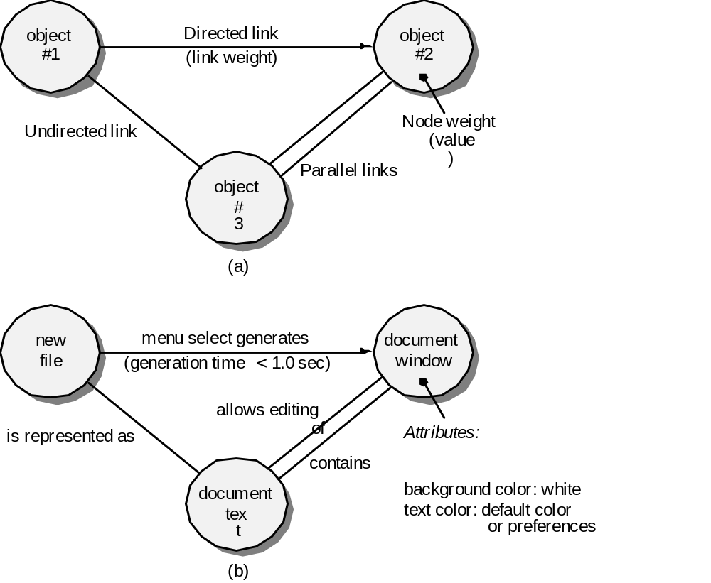
Graph-Based Methods
To understand the objects that are modeled in software and the relationships that connect these objects
In this context, we consider the term “objects” in the broadest possible context. It encompasses data objects, traditional components (modules), and object-oriented elements of computer software.

Slide 57
Equivalence Partitioning
A black-box testing method that divides the input domain of a program into classes of data from which test cases can be derived. This reduces the number of test cases that must otherwise be developed.
An ideal test case by itself uncover a class of errors that might otherwise require many cases to be executed before the general error is observed.
user
queries
output
formats
FK
input
mouse
picks
data
prompts

Slide 58
Sample Equivalence Classes
Valid data
user supplied commands
responses to system prompts
file names
computational data
physical parameters
bounding values
initiation values
output data formatting
responses to error messages
graphical data (e.g., mouse picks)
Invalid data
data outside bounds of the program
physically impossible data
proper value supplied in wrong place

Slide 59
Boundary Value Analysis (BVA)
To provide a better methodology to detect errors at the “boundaries”. Most engineers perform BVA intuitively.
user
queries
output
formats
FK
input
mouse
picks
data
prompts
output
domain
input domain

Slide 60
Comparison Testing
Used only in situations in which the reliability of software is absolutely critical (e.g., human-rated systems)
  Separate software engineering teams develop independent versions of an application using the same specification
  Each version can be tested with the same test data to ensure that all provide identical output
  Then all versions are executed in parallel with real-time comparison of results to ensure consistency

Slide 61
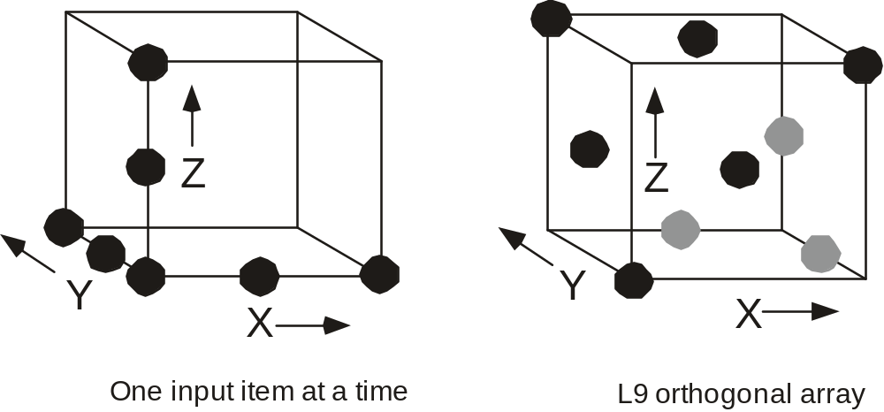
Orthogonal Array Testing
Used when the number of input parameters is small and the values that each of the parameters may take are clearly bounded. Exhaustive testing can be done!

Slide 62
Orthogonal Array Testing Example
Test Case | Test Parameters
 | P1 | P2 | P3 | P4
1 | 1 | 1 | 1 | 1
2 | 1 | 2 | 2 | 2
3 | 1 | 3 | 3 | 3
4 | 2 | 1 | 2 | 3
5 | 2 | 2 | 3 | 1
6 | 2 | 3 | 1 | 2
7 | 3 | 1 | 3 | 2
8 | 3 | 2 | 1 | 3
9 | 3 | 3 | 2 | 1

Slide 63
OOT—Test Case Design
Berard [BER93] proposes the following approach:
1. Each test case should be uniquely identified and should be explicitly associated with the class to be tested,
2. The purpose of the test should be stated,
3. A list of testing steps should be developed for each test and should contain [BER94]:
  a. a list of specified states for the object that is to be tested
b. a list of messages and operations that will be exercised as a consequence of the test
c. a list of exceptions that may occur as the object is tested
d. a list of external conditions (i.e., changes in the environment external to the software that must exist in order to properly conduct the test)
e. supplementary information that will aid in understanding or implementing the test.

Slide 64
Testing Methods
Fault-based testing
  The tester looks for plausible faults (i.e., aspects of the implementation of the system that may result in defects). To determine whether these faults exist, test cases are designed to exercise the design or code.
Class Testing and the Class Hierarchy
  Inheritance does not obviate the need for thorough testing of all derived classes. In fact, it can actually complicate the testing process.
Scenario-Based Test Design
  Scenario-based testing concentrates on what the user does, not what the product does. This means capturing the tasks (via use-cases) that the user has to perform, then applying them and their variants as tests.

Slide 65
OOT Methods: Random Testing
Random testing
  identify operations applicable to a class
  define constraints on their use
  identify a minimum test sequence
    an operation sequence that defines the minimum life history of the class (object)
  generate a variety of random (but valid) test sequences
    exercise other (more complex) class instance life histories

Slide 66
OOT Methods: Partition Testing
Partition Testing
  reduces the number of test cases required to test a class in much the same way as equivalence partitioning for conventional software
  state-based partitioning
    categorize and test operations based on their ability to change the state of a class
  attribute-based partitioning
    categorize and test operations based on the attributes that they use
  category-based partitioning
    categorize and test operations based on the generic function each performs

Slide 67
OOT Methods: Inter-Class Testing
Inter-class testing
  For each client class, use the list of class operators to generate a series of random test sequences. The operators will send messages to other server classes.
  For each message that is generated, determine the collaborator class and the corresponding operator in the server object.
  For each operator in the server object (that has been invoked by messages sent from the client object), determine the messages that it transmits.
  For each of the messages, determine the next level of operators that are invoked and incorporate these into the test sequence

Slide 68
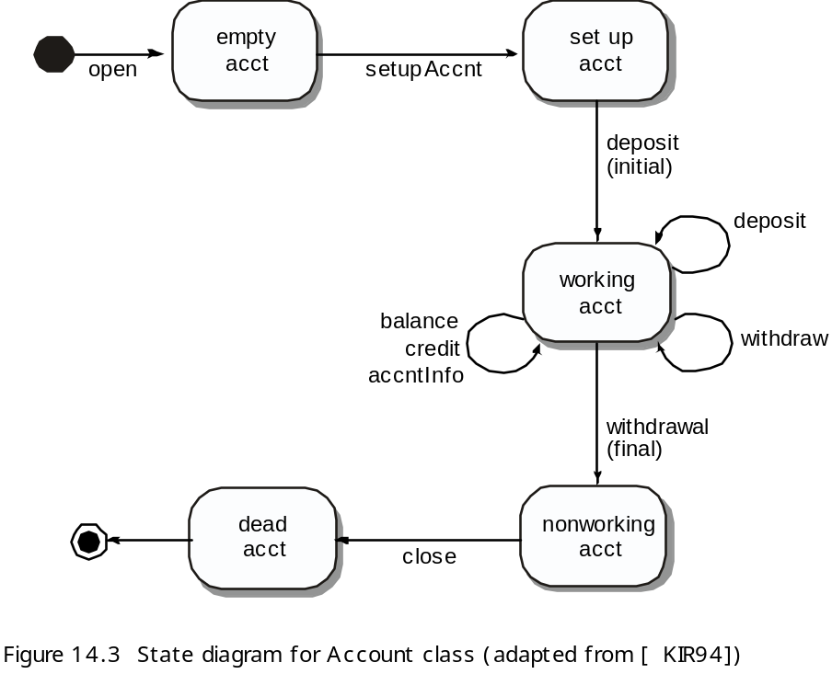
OOT Methods: Behavior Testing
The tests to be designed should achieve all state coverage [KIR94]. That is, the operation sequences should cause the Account class to make transition through all allowable states

Slide 69
Testing Patterns
Pattern name: pair testing
  Abstract: A process-oriented pattern, pair testing describes a technique that is analogous to pair programming (Chapter 4) in which two testers work together to design and execute a series of tests that can be applied to unit, integration or validation testing activities.
Pattern name: separate test interface
  Abstract: There is a need to test every class in an object-oriented system, including “internal classes” (i.e., classes that do not expose any interface outside of the component that used them). The separate test interface pattern describes how to create “a test interface that can be used to describe specific tests on classes that are visible only internally to a component.” [LAN01]
Pattern name: scenario testing
  Abstract: Once unit and integration tests have been conducted, there is a need to determine whether the software will perform in a manner that satisfies users. The scenario testing pattern describes a technique for exercising the software from the user’s point of view. A failure at this level indicates that the software has failed to meet a user visible requirement. [KAN01]

Slide 70
Chapter 15
Product Metrics for Software
“A science is as mature as its measurement tools”, Louis Pasteur

Slide 71
McCall’s Triangle of Quality
M
a
i
n
t
a
i
n
a
b
i
l
i
t
y
M
a
i
n
t
a
i
n
a
b
i
l
i
t
y
P
o
r
t
a
b
i
l
i
t
y
P
o
r
t
a
b
i
l
i
t
y
F
l
e
x
i
b
i
l
i
t
y
F
l
e
x
i
b
i
l
i
t
y
R
e
u
s
a
b
i
l
i
t
y
R
e
u
s
a
b
i
l
i
t
y
T
e
s
t
a
b
i
l
i
t
y
T
e
s
t
a
b
i
l
i
t
y
I
n
t
e
r
o
p
e
r
a
b
i
l
i
t
y
I
n
t
e
r
o
p
e
r
a
b
i
l
i
t
y
P
R
O
D
U
C
T
R
E
V
I
S
I
O
N
P
R
O
D
U
C
T
R
E
V
I
S
I
O
N
P
R
O
D
U
C
T
T
R
A
N
S
I
T
I
O
N
P
R
O
D
U
C
T
T
R
A
N
S
I
T
I
O
N
P
R
O
D
U
C
T
O
P
E
R
A
T
I
O
N
P
R
O
D
U
C
T
O
P
E
R
A
T
I
O
N
C
o
r
r
e
c
t
n
e
s
s
C
o
r
r
e
c
t
n
e
s
s
U
s
a
b
i
l
i
t
y
U
s
a
b
i
l
i
t
y
E
f
f
i
c
i
e
n
c
y
E
f
f
i
c
i
e
n
c
y
R
e
l
i
a
b
i
l
i
t
y
I
n
t
e
g
r
i
t
y
R
e
l
i
a
b
i
l
i
t
y
I
n
t
e
g
r
i
t
y

Slide 72
A Comment
McCall’s quality factors were proposed in the
early 1970s. They are as valid today as they were
in that time. It’s likely that software built to conform
to these factors will exhibit high quality well into
the 21st century, even if there are dramatic changes
in technology.

Slide 73
Measures, Metrics and Indicators
A measure provides a quantitative indication of the extent, amount, dimension, capacity, or size of some attribute of a product or process
The IEEE glossary defines a metric as “a quantitative measure of the degree to which a system, component, or process possesses a given attribute.”
An indicator is a metric or combination of metrics that provide insight into the software process, a software project, or the product itself

Slide 74
Measurement Principles
The objectives of measurement should be established before data collection begins;
Each technical metric should be defined in an unambiguous manner;
Metrics should be derived based on a theory that is valid for the domain of application (e.g., metrics for design should draw upon basic design concepts and principles and attempt to provide an indication of the presence of an attribute that is deemed desirable);
Metrics should be tailored to best accommodate specific products and processes [BAS84]

Slide 75
Measurement Process
Formulation. The derivation of software measures and metrics appropriate for the representation of the software that is being considered.
Collection. The mechanism used to accumulate data required to derive the formulated metrics.
Analysis. The computation of metrics and the application of mathematical tools.
Interpretation. The evaluation of metrics results in an effort to gain insight into the quality of the representation.
Feedback. Recommendations derived from the interpretation of product metrics transmitted to the software team.

Slide 76
Goal-Oriented Software Measurement
The Goal/Question/Metric Paradigm
  (1) establish an explicit measurement goal that is specific to the process activity or product characteristic that is to be assessed
  (2) define a set of questions that must be answered in order to achieve the goal, and
  (3) identify well-formulated metrics that help to answer these questions.
Goal definition template
  Analyze {the name of activity or attribute to be measured}
  for the purpose of {the overall objective of the analysis}
  with respect to {the aspect of the activity or attribute that is considered}
  from the viewpoint of {the people who have an interest in the measurement}
  in the context of {the environment in which the measurement takes place}.

Slide 77
Metrics Attributes
simple and computable. It should be relatively easy to learn how to derive the metric, and its computation should not demand inordinate effort or time
empirically and intuitively persuasive. The metric should satisfy the engineer’s intuitive notions about the product attribute under consideration
consistent and objective. The metric should always yield results that are unambiguous.
consistent in its use of units and dimensions. The mathematical computation of the metric should use measures that do not lead to bizarre combinations of unit.
programming language independent. Metrics should be based on the analysis model, the design model, or the structure of the program itself.
an effective mechanism for quality feedback. That is, the metric should provide a software engineer with information that can lead to a higher quality end product

Slide 78
Collection and Analysis Principles
Whenever possible, data collection and analysis should be automated;
Valid statistical techniques should be applied to establish relationship between internal product attributes and external quality characteristics
Interpretative guidelines and recommendations should be established for each metric

Slide 79
Analysis Metrics
Function-based metrics: use the function point as a normalizing factor or as a measure of the “size” of the specification
Specification metrics: used as an indication of quality by measuring number of requirements by type

Slide 80
Function-Based Metrics
The function point metric (FP), first proposed by Albrecht [ALB79], can be used effectively as a means for measuring the functionality delivered by a system.
Function points are derived using an empirical relationship based on countable (direct) measures of software's information domain and assessments of software complexity
Information domain values are defined in the following manner:
  number of external inputs (EIs)
  number of external outputs (EOs)
  number of external inquiries (EQs)
  number of internal logical files (ILFs)
  Number of external interface files (EIFs)

Slide 81
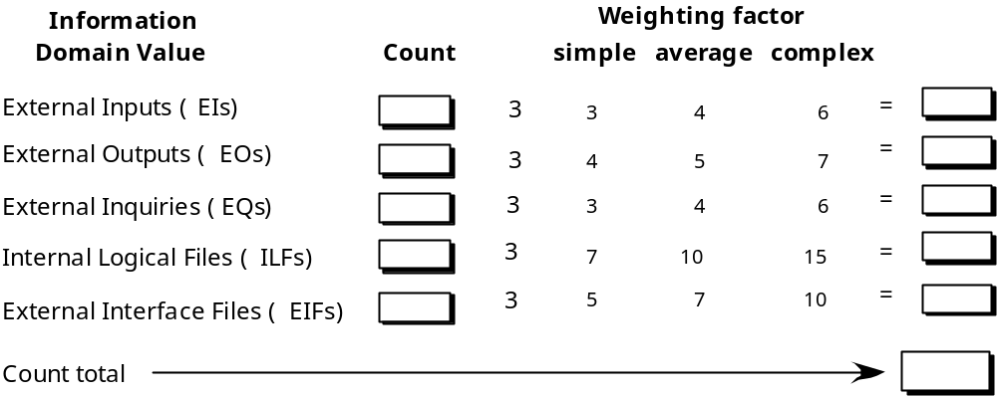
Function Points

Slide 82
Function Points
Information
Weighting factor
Domain Value
Count
simple average complex
External Inputs (
EIs
)
3
2
2
1
4
x
3
4
6
=
9
8
6
7
20
50
External Outputs (
EOs
)
x
4
5
7
=
External Inquiries (
EQs
)
x
3
4
6
=
Internal Logical Files (
ILFs
)
x
7
10
15
=
External Interface Files (
EIFs
)
x
5
7
10
=
Count total
Assume that past data indicates that one FP translates into X lines of code

Slide 83
Function Points
Information
Weighting factor
Domain Value
Count
simple average complex
3
2
2
1
4
External Inputs (
EIs
)
x
3
4
6
=
9
8
6
7
20
50
External Outputs (
EOs
)
x
4
5
7
=
External Inquiries (
EQs
)
x
3
4
6
=
Internal Logical Files (
ILFs
)
x
7
10
15
=
External Interface Files (
EIFs
)
x
5
7
10
=
Count total
Assume that past data indicates that one FP translates into X lines of code

Slide 84
Metrics for Specification Quality
Assume that there are Nr requirements in a specification with Nf functional requirements and Nnf non-functional requirements, then
  Nr = Nf + Nnf
Now if Nui is the number of requirements for which all reviewers had identical interpretation, then the specificity (lack of ambiguity) of requirements is given by:
  Q1 = Nui/Nr
The closer Q1 to 1 the lower is the ambiguity
If Nu = # of unique function requirements, and Ni = # of inputs defined or implied by the specification, and Ns = number of states specified, then the completeness of functional requirements is given by:
  Q2 = Nu/(Ni x Ns)
If Nc = # of requirements that have been validated as correct and Nnv = # of requirements not yet validated, then the degree to which the requirements have been validated is given by:
  Q3 = Nc/(Nc + Nnv)

Slide 85
Architectural Design Metrics
Architectural design metrics
  Structural complexity = g(fan-out)
  Data complexity = f(input & output variables, fan-out)
  System complexity = h(structural & data complexity)
HK metric: architectural complexity as a function of fan-in and fan-out
Morphology metrics: a function of the number of modules and the number of interfaces between modules
Fan-out is defined as the number of modules immediately subordinate to the
module i, that is, the # of modules that are directly invoked by module that are
directly invoked by module i. Fan-in is defined as the # of modules that directly
invoke module i

Slide 86
Metrics for OO Design-I
Whitmire [WHI97] describes nine distinct and measurable characteristics of an OO design:
  Size
    Size is defined in terms of four views: population, volume, length, and functionality
  Complexity
    How classes of an OO design are interrelated to one another
  Coupling
    The physical connections between elements of the OO design
  Sufficiency
    “the degree to which an abstraction possesses the features required of it, or the degree to which a design component possesses features in its abstraction, from the point of view of the current application.”
  Completeness
    An indirect implication about the degree to which the abstraction or design component can be reused

Slide 87
Metrics for OO Design-II
  Cohesion
    The degree to which all operations working together to achieve a single, well-defined purpose
  Primitiveness
    Applied to both operations and classes, the degree to which an operation is atomic
  Similarity
    The degree to which two or more classes are similar in terms of their structure, function, behavior, or purpose
  Volatility
    Measures the likelihood that a change will occur

Slide 88
Distinguishing Characteristics
Berard [BER95] argues that the following characteristics require
that special OO metrics be developed:
Localization—the way in which information is concentrated in a program
Encapsulation—the packaging of data and processing
Information hiding—the way in which information about operational details is hidden by a secure interface
Inheritance—the manner in which the responsibilities of one class are propagated to another
Abstraction—the mechanism that allows a design to focus on essential details

Slide 89
Class-Oriented Metrics
Proposed by Chidamber and Kemerer:
weighted methods per class (WMC)
depth of the inheritance tree (DIT)
number of children (NOC)
coupling between object classes (CBO)
response for a class (RFC)
lack of cohesion in methods (LCOM)

Slide 90
Class-Oriented Metrics
Proposed by Lorenz and Kidd [LOR94]:
class size
number of operations overridden by a subclass
number of operations added by a subclass
specialization index

Slide 91
Class-Oriented Metrics
The MOOD Metrics Suite
Method inheritance factor (MIF)
Coupling factor (CF)
Polymorphism factor

Slide 92
Operation-Oriented Metrics
Proposed by Lorenz and Kidd [LOR94]:
average operation size (OSavg)
operation complexity (OC)
average number of parameters per operation (NPavg)

Slide 93
Component-Level Design Metrics
Cohesion metrics: a function of data objects and the locus of their definition
Coupling metrics: a function of input and output parameters, global variables, and modules called
Complexity metrics: hundreds have been proposed (e.g., cyclomatic complexity) – used to predict critical information about reliability and maintainability of S/W systems.

Slide 94
Interface Design Metrics
Layout appropriateness (LA): a function of layout entities, the geographic position and the “cost” of making transitions among entities

Slide 95
Code Metrics
Halstead’s theory of “Software Science” proposed the first analytical “laws” for computer software : a comprehensive collection of metrics all predicated on the number (count and occurrence) of operators and operands within a component or program
  It should be noted that Halstead’s “laws” have generated substantial controversy, and many believe that the underlying theory has flaws. However, experimental verification for selected programming languages has been performed (e.g. [FEL89]).

Slide 96
Metrics for Testing
Testing effort can also be estimated using metrics derived from Halstead measures
Binder [BIN94] suggests a broad array of design metrics that have a direct influence on the “testability” of an OO system.
  Lack of cohesion in methods (LCOM).
  Percent public and protected (PAP).
  Public access to data members (PAD).
  Number of root classes (NOR).
  Fan-in (FIN).
  Number of children (NOC) and depth of the inheritance tree (DIT).

